Slide 1
Dermatoses of Pregnancy
Eric Robbins
MS3, Tufts University School of Medicine

Slide 2
Dermatoses
Polymorphic eruption of pregnancy (PEP) – formerly PUPPP
Atopic eruption of pregnancy (AEP)
Pemiphigoid gestationis (PG)– formerly herpes gestationis
Intrahepatic cholestasis of pregnancy (ICP)

Slide 3
Overview
 | Onset | Maternal Risk | Fetal Risk | Treatment
AEP | 1st, 2nd | none | none | Emollients, topical steroids
PEP | 3rd, PP | none | none | Emollients, corticosteroids, anti-histamines
ICP | late 2nd, early 3rd | labor induction, cholelithiasis, steatorrhea, IPH | mec staining, preterm delivery, IUFD | UDCA
PG | 2nd, 3rd | ++ risk of Grave disease | preterm birth, low birth weight | topical and systemic corticosteroids, antihistamines

Slide 4
AEP – Atopic Eruption of Pregnancy
Definition: exacerbation or the first occurrence of eczematous and/or papular skin changes during pregnancy in patients with an atopic diathesis
Presentation: Eczematous rash at classic atopic sites
Histopathology: non-specific
Labs: no dx lab; inc. serum IgE in 20%-70% pts
Management: Emollients; low/mid-potency topical steroids; 1st gen H1 antagonists. Refractory cases can consider UVB photo-tx, short course of

Slide 5
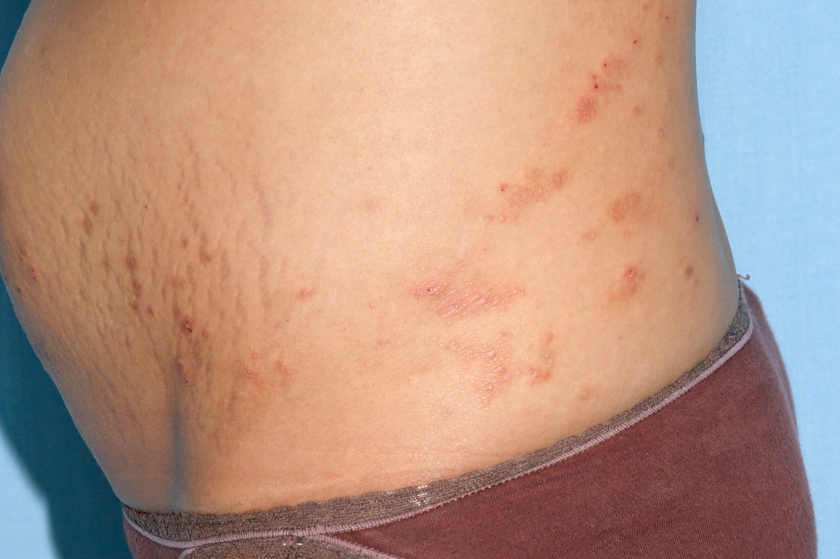
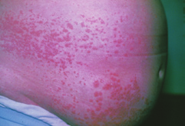
AEP – Atopic Eruption of Pregnancy

Slide 6
PEP – Polymorphic Eruption of Pregnancy
Incidence: 0.5% singleton, 2.9% twins, 14% triplets
Pathogenesis: unclear
Presentation: intensely pruritic urticarial papules and plaques abruptly arising first in striae on gravid abdomen and then spreading to the trunk and extremities. Ofte sparing of face, palms, and soles; mucosa is not involved.
Histopathology: non-specific
Labs: normal
Management: Emollients; low/mid-potency topical steroids; 1st gen H1 antagonists. Refractory cases can consider UVB photo-tx.

Slide 7
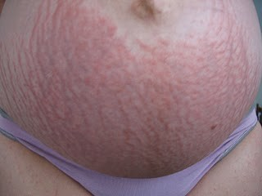
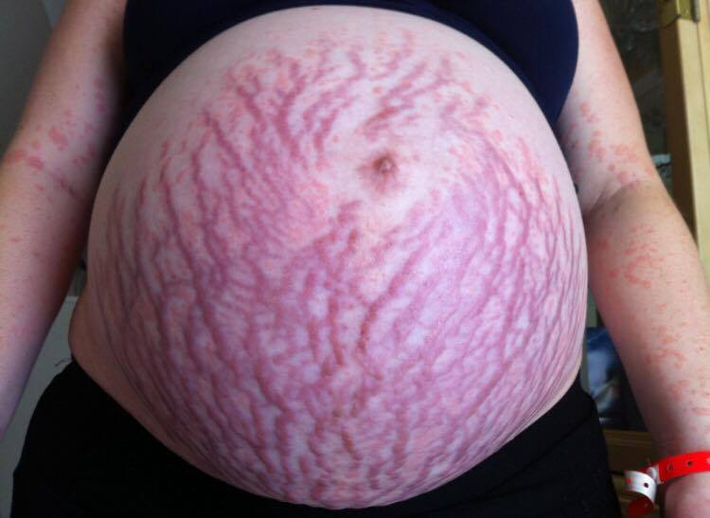
PEP – Polymorphic Eruption of Pregnancy

Slide 8
ICP
Incidence: 0.1% (European)-28% (Araucanian)
Pathogenesis: Hormonally triggered reversible cholestasis in late pregnancy. Fetal compromise 2/2 acute placental anoxia and cardiac depression.
Presentation: No primary skin lesions, but secondary changes from scratching. Sudden-onset severe pruritis. Often involves hands & soles.
Labs: Serum bile acids >11umol/L
Management: UDCA (improves fetal prognosis); delivery.

Slide 9
PG – Pemphigoid Gestationis
Incidence: 1 in 50,000 pregnancies
Pathogenesis: MHC-II in amniochorionic stromal cells and trophoblasts, exposing BP180 antigen to maternal immune system. Maternal anti-placental IgG Ab then cross-react w/ BP180 in skin.
Presentation: Utricarial papules/plaques along w/ vesicles and bullae. Unlike PEP, typically involves umbilicus. Spontaneous remission following delivery common.
Histopathology: Immunofluorescence shows C3 +/- IgG along basement membrane
Management: Goal--reduce pruritis.Emollients, topical steroids, PO. Refractory cases: IVIG.

Slide 10
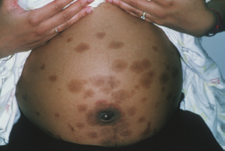
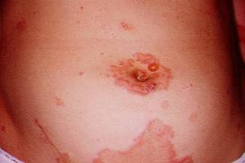
PG - Pemphigoid Gestationis
Courtesy of http://www.pcds.org.uk/clinical-guidance/pregnancy-related-conditions

Slide 11
Overview
 | Onset | Maternal Risk | Fetal Risk | Treatment
AEP | 1st, 2nd | none | none | Emollients, topical steroids
PEP | 3rd, PP | none | none | Emollients, corticosteroids, anti-histamines
ICP | late 2nd, early 3rd | labor induction, cholelithiasis, steatorrhea, IPH | mec staining, preterm delivery, IUFD | UDCA
PG | 2nd, 3rd | ++ risk of Grave disease | preterm birth, low birth weight | topical and systemic corticosteroids, antihistamines

Slide 12
References
Common Skin Conditions During Pregnancy. Am Fam Physician. 2007 Jan 15;75(2):211-218.
BECHTEL, M. A., & PLOTNER, A. (2015). Dermatoses of Pregnancy. Clinical Obstetrics and Gynecology, 58(1), 104–111. https://doi.org/10.1097/grf.0000000000000080
Lehrhoff, S., & Pomeranz, M. K. (2013). Specific dermatoses of pregnancy and their treatment. Dermatologic Therapy, 26(4), 274–284. https://doi.org/10.1111/dth.12078

